Slide 1
Contemporary Moral Problems
M-F12:00-1:00SAV 264
Instructor: Benjamin Hole
Email: bvhole@uw.edu
Office Hours: everyday after class

Slide 2

Agenda
Admin / where we are / context ….
Last thoughts on Hardin’s argument?
Clicker Quiz: Dworkin
Ronald Dworkin, “Liberty and Pornography”

Slide 3
Week | Required Reading | Assignment
Course Mechanics, Theory Primer, and Philosophical Argumentation 6/23-6/27 | Benjamin Hole, Phil 102 Syllabus Lewis Vaughn (posted on website), “How to Read an Argument” Mark Timmons, “Moral Theory Primer” | WA1, due 6/27
Philosophical Writing and Ethical Theory 6/30-7/3 (Holiday, 7/4) | Mark B. Woodhouse (posted on website), “How to Write Philosophy” James Rachels (posted on website), “The Challenge of Cultural Relativism” Jeremy Bentham (posted on website), “The Principle of Utility” Robert Nozick, “The Experience Machine” (posted on website) | None
Ethical Theory 7/7-7/11 | J.S. Mill (electronic), On Liberty, Chapters 1-2 Immanuel Kant (posted on website), “The Moral Law” | WA2, due 7/8
Introduction to Sexual Ethics 7/14-7/18 | Thomas Mappes, “A Liberal View of Sexual Morality and the concept of Using Another Person” The Catholic Church, “Vatican Declaration on Some Questions in Sexual Ethics” John Corvino, “A Defense of Homosexuality” | None
Introduction to International Ethics 7/21-7/25 | Peter Singer, “Famine, Affluence, and Morality” (posted on website) Garrett Hardin, “Lifeboat Ethics” (posted on website) | WA3, due 7/22
Introduction to Social and Political Ethics: Censorship and Pornography 7/28-8/1 | Ronald Dworkin, “Liberty and Pornography” Judith M. Hill, “Pornography and Degradation” Catharine MacKinnon (posted on website), “Pornography, Civil Rights, and Speech” | None
Abortion 8/4-8/8 | Pope John Paul II, “The Unspeakable Crime of Abortion” Mary Anne Warren, “On the Moral and Legal Status of Abortion” Don Marquis, “Why Abortion Is Immoral” | WA4, due 8/5
Conference for Final Papers 8/11-8/15 | Catch-up if we’ve fallen behind. Conference for Final Papers: presentations and discussion | None
Abortion 8/18-8/22 | Judith Jarvis Thomson, “A Defense of Abortion” Rosalind Hursthouse, “Virtue Ethics and Abortion” | WA5, due 8/19 Final Paper, due 8/21

Slide 4
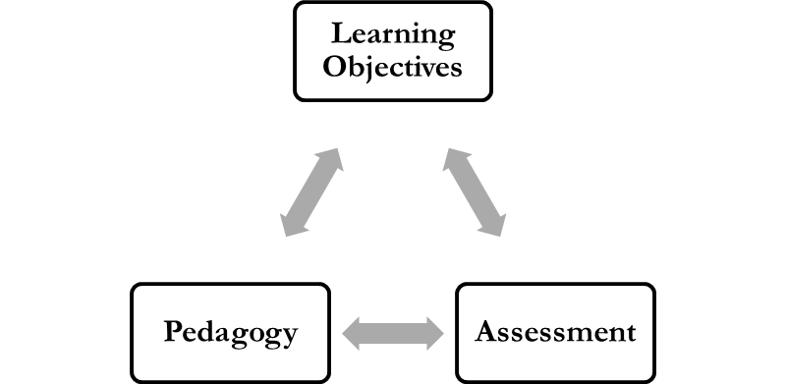
Writing Assignment Four
Paper Presentations
Develop Critical Arguments
Self-Assessment of Learning
Are you self-regulating your learning?
Self-assess your participation.

Slide 5
Final paper (outline) questions?

Slide 6

Conference and Journal Calls for Papers
https://canvas.uw.edu/courses/884483/discussion_topics/1913311
http://uwphilosophyundergrads.wordpress.com

Slide 7
Garrett Hardin, “Lifeboat Ethics”
Last thoughts on his argument ….

Slide 8
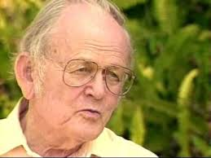
Hardin's Argument
1. We should adopt those policies that lead to the best long term benefits for everyone.
2. Helping the poor, in terms of a World Food Bank or liberal immigration policies, would lead to the destruction of the environment and a ruined world for future generations.
3. It follows that we should not adopt the aforementioned policies.

Slide 9
Who has the better argument?
Hardin
Singer
Neither

Slide 10
Clicker Quiz
Ronald Dworkin, “Liberty and Pornography”

Slide 11
Dworkin adopts, from Isaiah Berlin’s famous lecture, “Two Concepts of Liberty”:
the distinction between positive and negative liberties
the utilitarian harm principle
utilitarian experiments in living
the right not to be degraded by pornography
A & D
none of the above

Slide 12
The right to free speech, according to Dworkin, is an example of:
positive liberty
negative liberty
neutral liberty
none of the above

Slide 13
The right to vote, according to Dworkin, is an example of:
positive liberty
negative liberty
neutral liberty
none of the above

Slide 14
Introduction to Censorship and Pornography

Slide 15
Rights Based Moral Theory
“An action is right if and only if (and because) in performing it either (a) one does not violate the fundamental moral rights of others, or (b) in cases where it is not possible to respect all such rights because they are in conflict, one’s action is among the best ways to protect the most important rights in the case at hand” (22).

Slide 16
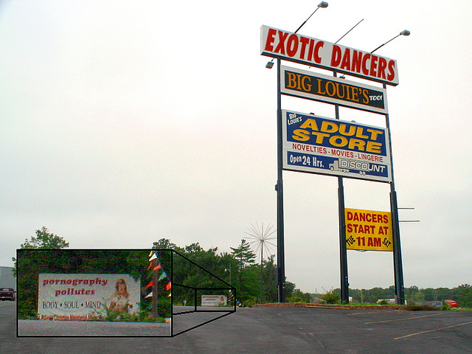
Freedom of Speech
Our test case will be pornography.
We will look at three different stories we could tell:
Feminist
Liberal
Conservative

Slide 17
Feminism and Freedom of Speech
Feminism is not one view, but a body of views
When it comes to pornography and censorship:
“Feminists disagree about what sexism consists in, and what exactly ought to be done about it ... Nonetheless, motivated by the quest for social justice, feminist inquiry provides a wide range of perspectives on social, cultural, economic, and political phenomena.” <http://plato.stanford.edu/entries/feminism-topics/>
For example, Catherine MacKinnon argues that pornography is an immoral institution because it marginalizes women.

Slide 18
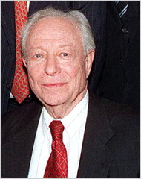
Conservative view on pornography
Irving Kristol (1920 –2009)
Grandfather of the neoconservative movement
Defined a neoconservative as “a liberal who has been mugged by reality”
Editor and founder The National Interest
Notes:
Core ideas: limited government power, but also a sense that people need to be a certain kind of way for the state to succeed.

Slide 19
Conservative view on pornography
The Moralism Argument for Censorship
Some forms of entertainment make us less human, by depicting humans in a manner ignoring their humanity.
Notes:
Core ideas: limited government power, but also a sense that people need to be a certain kind of way for the state to succeed.

Slide 20
The Moralism Argument for Censorship
Strongly Agree
Agree
Somewhat Agree
Neutral
Somewhat Disagree
Disagree
Strongly Disagree

Slide 21
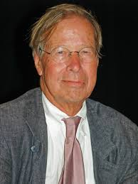
Ronald Dworkin, “Liberty and Pornography”

Slide 22
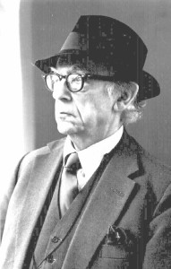
Ronald Dworkin, “Liberty and Pornography”
Discussion of Isaiah Berlin's “Two Concepts of Liberty”
Two kinds of liberty:
Negative liberty: liberty to not be obstructed by others in doing what one wishes to do
Positive liberty: power to control or participate in public decisions

Slide 23
The distinction between positive and negative liberties
Strongly Agree
Agree
Somewhat Agree
Neutral
Somewhat Disagree
Disagree
Strongly Disagree

Slide 24
Ronald Dworkin, “Liberty and Pornography”
Discussion of Isaiah Berlin's “Two Concepts of Liberty”
Two kinds of liberty:
Negative liberty: liberty to not be obstructed by others in doing what one wishes to do
Positive liberty: power to control or participate in public decisions
The complexity of political value
The “Platonic ideal”: all the political virtues can be realized in a single political structure
Platonic ideal “a seductive myth”; some freedoms conflict with others

Slide 25
Dworkin: Two Kinds of Liberty
Mill’s Harm Principle: In the absence of some direct harm to a non-consenting other person, there is no justification for coercion.
Freedom of speech is a negative right.
Most speech, including most forms of pornography, does not directly harm a non-consenting other person.
Given a liberal perspective, such as the harm principle, negative rights trump positive rights.

Slide 26
Dworkin: Two Kinds of Liberty
One argument against pornography
Dworkin's objection
It conflicts with equality and women's positive liberty.
This is a causal argument, and as such is “strikingly implausible.” Moreover, the negative causal influence of television and other aspects of popular culture is probably much greater than that of pornography.

Slide 27
Pornography conflicts with equality and women's positive liberty.
Strongly Agree
Agree
Somewhat Agree
Neutral
Somewhat Disagree
Disagree
Strongly Disagree

Slide 28
Dworkin: Two Kinds of Liberty
Another argument against pornography
Dworkin's objection
Frank Michelman
Pornography SILENCES women.
Although it is possible that pornography could violate a positive right, it does not deprive others of their negative liberty to speak.

Slide 29
Dworkin: Two Kinds of Liberty
The pro-censorship feminist arguments in question can be understood as appealing to women’s positive liberty to participate equally with men in community.
The idea, then, is that the positive liberty in question ought to limit the negative liberty of free speech and expression when it comes to pornography.
Dworkin instead argues that even if pornography interferes with women’s positive liberty to participate in political processes, this would not justify censoring pornography.

Slide 30
Even if pornography interferes with women’s positive liberty to participate in political processes, this would not justify censoring pornography.
Strongly Agree
Agree
Somewhat Agree
Neutral
Somewhat Disagree
Disagree
Strongly Disagree

